Slide 1
DAMG 6210-
Music Database System
By : Maruti Mohit Rayalacheruvu
Meghana Sai Vattikuti
Prakruthi Panakanahalli Somashekaraish
Sumanayana Konda

Slide 2

What is Music Database System?
Music Database System project is an essential tool for managing music data and streamlining music-related tasks.
It provides a secure and efficient way to manage music data, ensuring that users can easily search, stream, and organize their music collections.
It has 3 roles (User, Artist and Admin) and 9 Tables working together to achieve the following advantages or aims

Slide 3
ADVANTAGES
The Music Database System provides a centralized location to manage music data, which can reduce the chances of data inconsistencies and errors.
Centralized Music Data Management
The system offers different levels of access control to ensure that only authorized users can access and modify data.
Access Control
Protection against data loss, corruption, and unauthorized access by implementing data backup and recovery strategies.
Data Security
can be customized to fit the needs of different user roles, providing a flexible and adaptable platform for managing music data.
Customizability

Slide 4
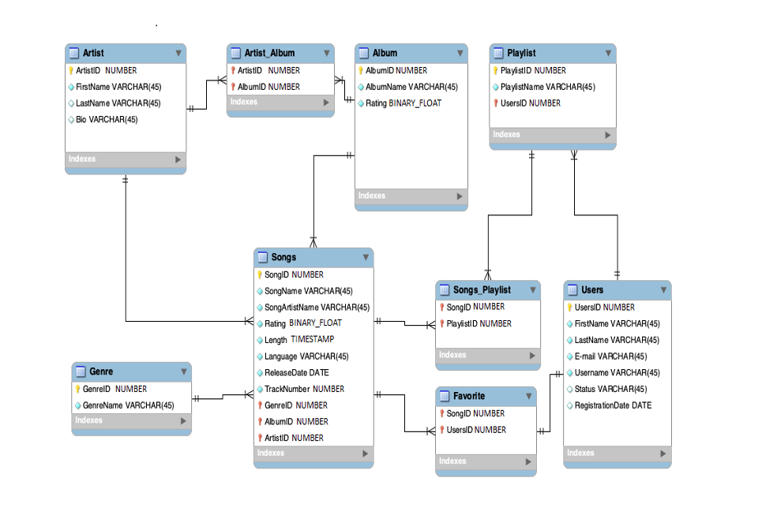
The ER Diagram

Slide 5
Roles and Business Rules
The Artist manages his music
Admin
Users
Create/Manage Users
Add/Remove Songs, Albums
Create/Manage Artists
View User data
Add ratings for Songs
Create/Manage Playlists
View Songs, Artists, Albums
View/Update their own data
Cannot make changes to others data
Upload Albums, Songs
View/Update own Artist data
View Ratings
Cannot make changes to others data
The App Admin manages the entire system
Artist
The User can experience an effective music database system

Slide 6
Views
A view is a virtual table based on the results of a SQL statement. The fields in view are fields from one or more real tables in the database.
1 | 2 | 3 | 4 | 5 | 6
No of Songs in Genre | No of Songs in Playlist | Songs by Rating | Songs by Artist | Active Users | Users Genre preference
Genre Name Song Count | Playlist ID Playlist Name Song Count | Song ID Song Name Songs Artist Song Album Rating | Artist ID Artist Name Song Count | User ID User Fname User Lname | User ID Username Genre Prefer Count

Slide 7
Views
A view is a virtual table based on the results of a SQL statement. The fields in view are fields from one or more real tables in the database.
7 | 8 | 9
Display Fav Song | Recommendations | Most rated Album
Song ID Song Name Song Artist ID Song Genre ID Song Rating | Song ID Song Artist Name | Album ID Album Name Average Song Rating

Slide 8
Views Granted to USERS
Songs By Rating
User Favorites
Can see all the songs depending on rating
Can View the Songs Favorited by the Users
USER
User Recommendations
Artist Song Count
Can View the song Recommendations by the System
Can View Number of Songs released by an Artist
Top Rated Albums
User Genre Preference
Can View the top rated albums along with their Artists
Can View the Genre Preferred by the User

Slide 9

Views Granted to Artists
Song Count By Genre
Songs By Rating
Can view the Songs Count in a Genre
Can View Songs and their Rating
Song Count
Top Rated Album
Can View the Count of All Songs by Artist
Can View their Top Rated Album

Slide 10
Packages and Procedures
INSERT-DELETE PACKAGE
ARTIST PACKAGE
USER PACKAGE
Insert/Update/Delete Artist (Deletes all songs of Artist)
Insert/Update/Delete Album
Insert/Update Genre
Insert/Update User
Insert/Update/Delete Song
Insert/Update/Delete Playlist
Insert/Update/Delete Artist_Album
Insert/Update/Delete Songs_Playlist
Insert/Update/Delete Favorites
Update Artist Data
Insert Album
Insert Song
Insert Artist_Album
Triggers:
Check Album Rating
Check Song Rating
Check Artist Name
Check User Email
Update Song Artist Name
Add Favorites
Update User Data
Delete Favorites
Add Playlist
Insert Songs to Playlist
Delete Song From Playlist
Delete Playlist

Slide 11
Steps to the Run Scripts
Creates Artist and User with permissions
Creates App Admin with necessary Permissions
1
6
Roles/
Users
Super Admin
Tables and values are created by the app admin
2
All the Views are Run by App Admin
Tables
Data base
5
Views
Packages and Procedures are run by the App Admin
3
Data is Inserted into the Tables by Admin
Packages
4
Data Insertion

Slide 12
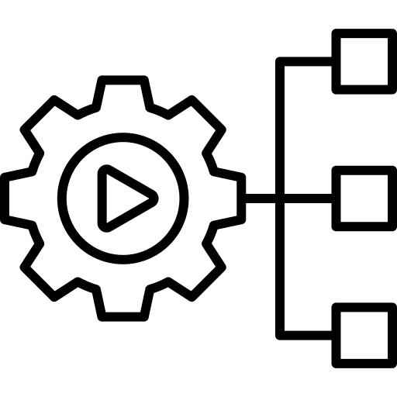
THANK YOU

